Slide 1
Titanic survival prediction
Learning
Data processing
Model Training
Model Evaluation
Data Visualization
Making Predictions on New Data
Practical Skills Gained
Pandas
Scikit-learn
Seaborn
Matplotlib
Model Evaluation Metrics
By:-
Sahil arya

Slide 2
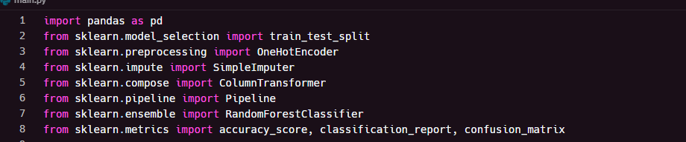
Imported libraries

Slide 3
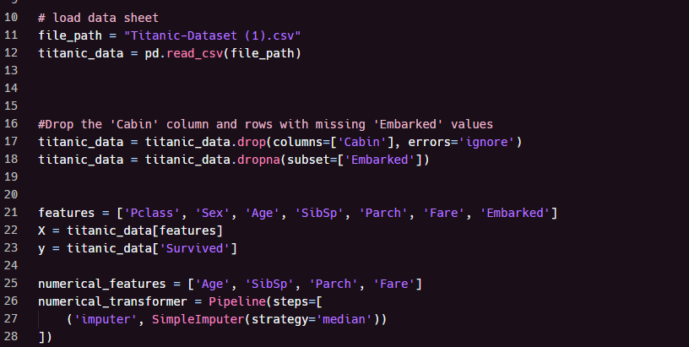
File path

Slide 4
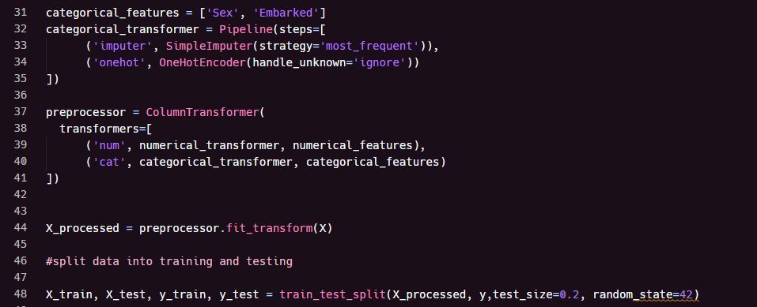
Check missing values and Encode the target variable

Slide 5
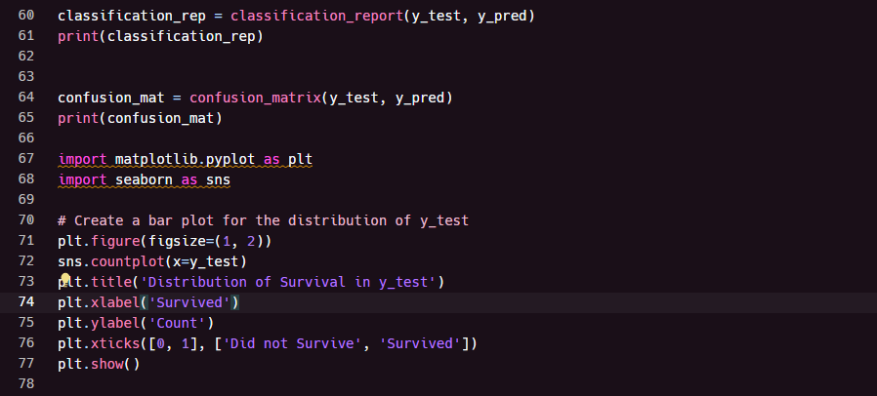
Plot

Slide 6
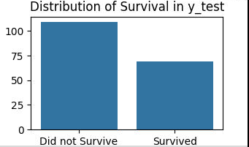
Graph

